Slide 1
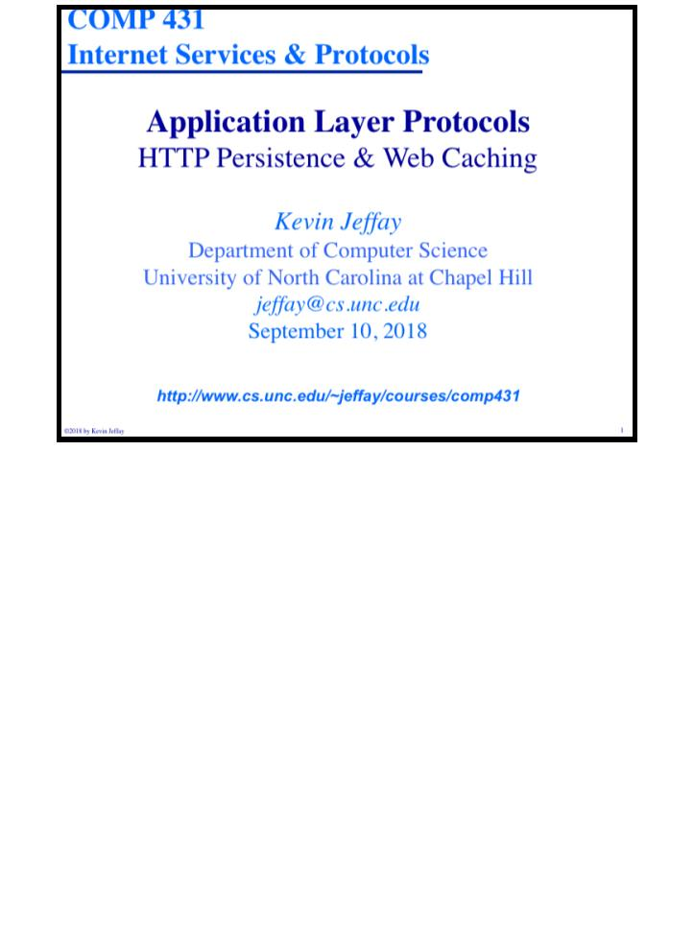
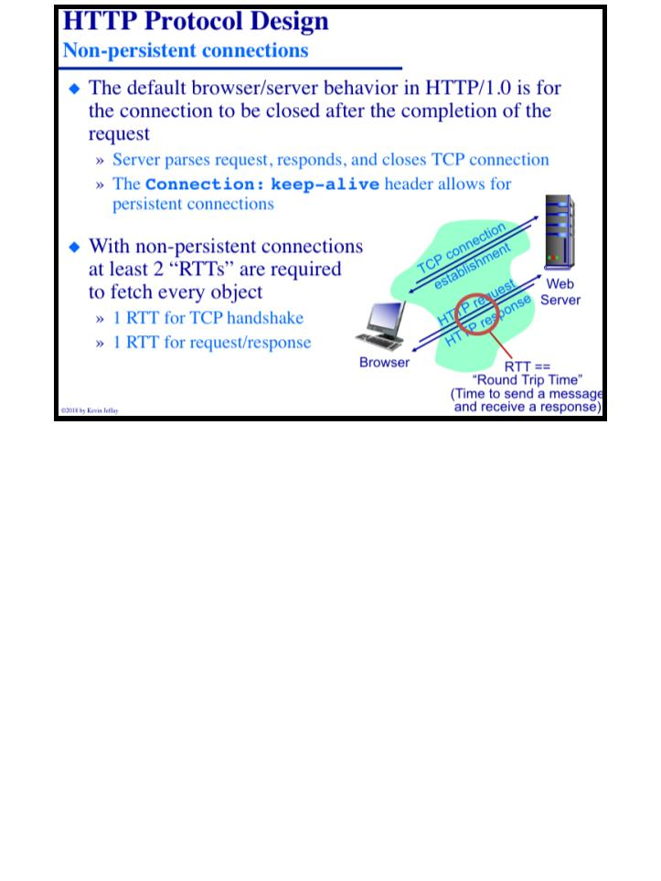
COMP 431
Lecture 5, HTTP Persistence & Caching
September 10, 2018
COMP 431
© 2018 by Kevin Jeffay
Lecture 5, HTTP Persistence & Caching
September 10, 2018
© 2018 by Kevin Jeffay
Page 1
Page 2

Slide 2
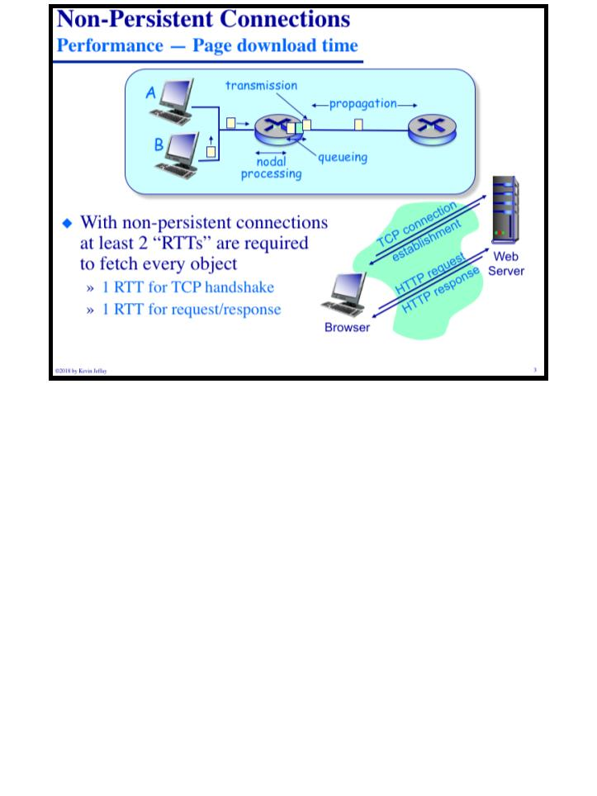
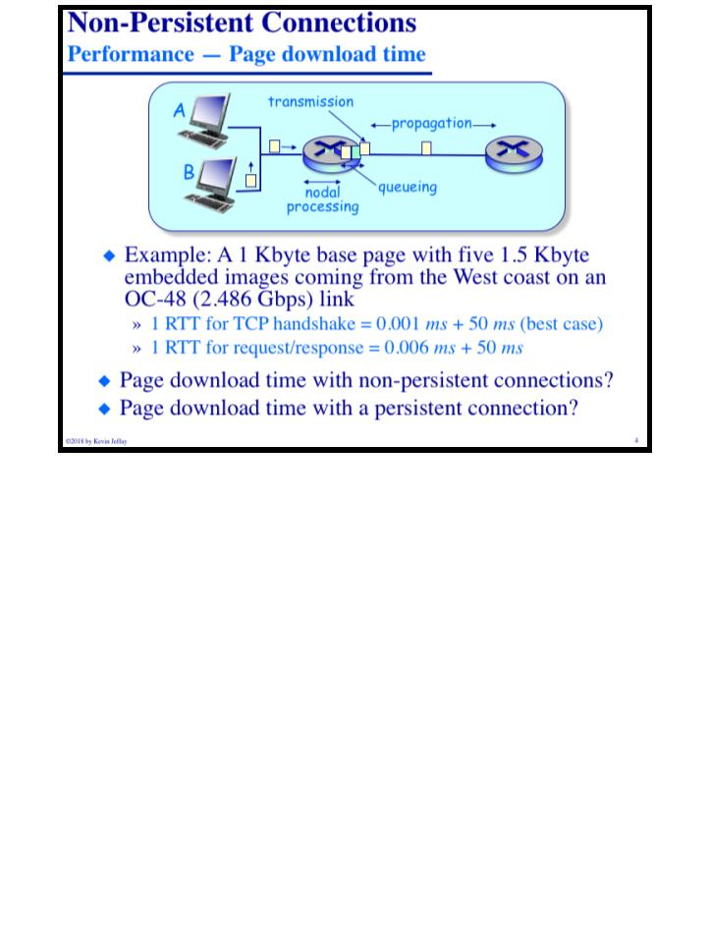
COMP 431
Lecture 5, HTTP Persistence & Caching
September 10, 2018
COMP 431
© 2018 by Kevin Jeffay
Lecture 5, HTTP Persistence & Caching
September 10, 2018
© 2018 by Kevin Jeffay
Page 3
Page 4

Slide 3
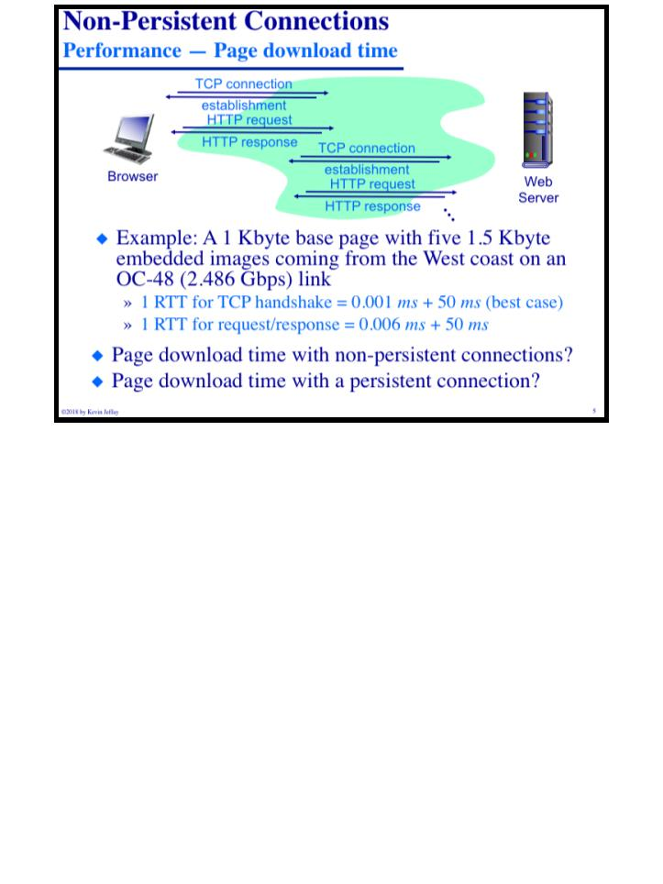
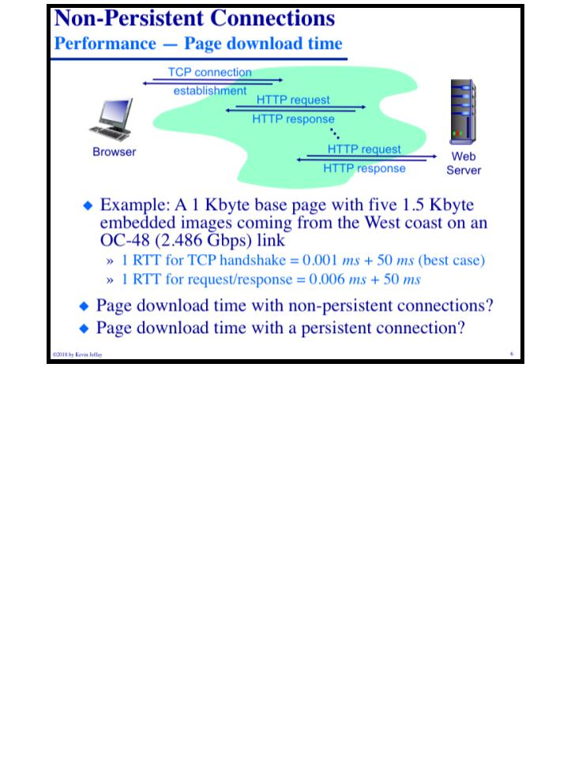
COMP 431
Lecture 5, HTTP Persistence & Caching
September 10, 2018
COMP 431
© 2018 by Kevin Jeffay
Lecture 5, HTTP Persistence & Caching
September 10, 2018
© 2018 by Kevin Jeffay
Page 5
Page 6

Slide 4
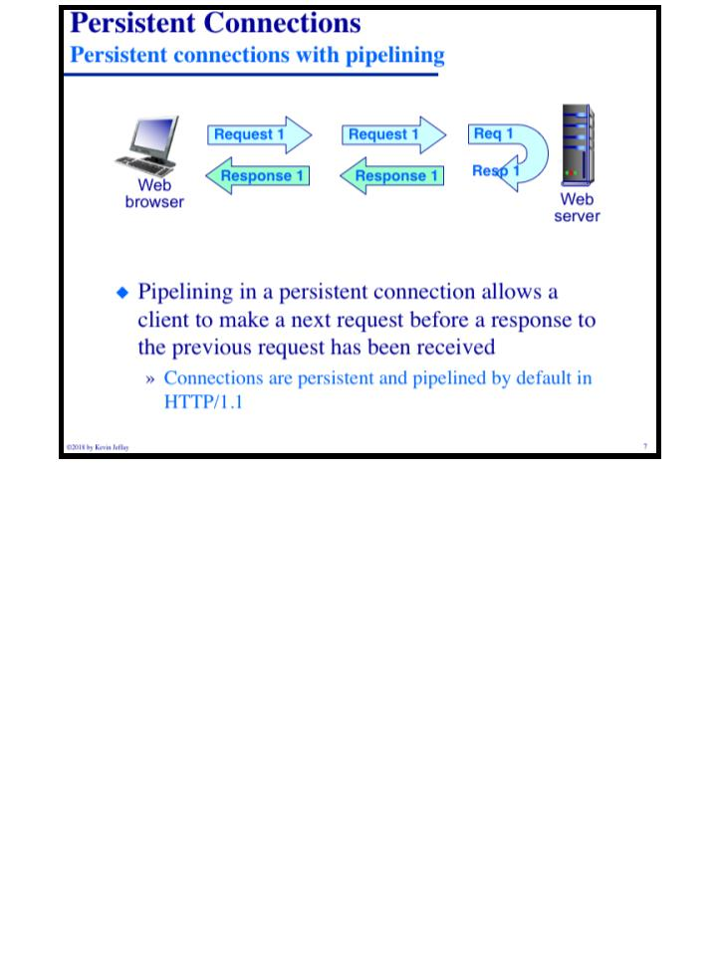
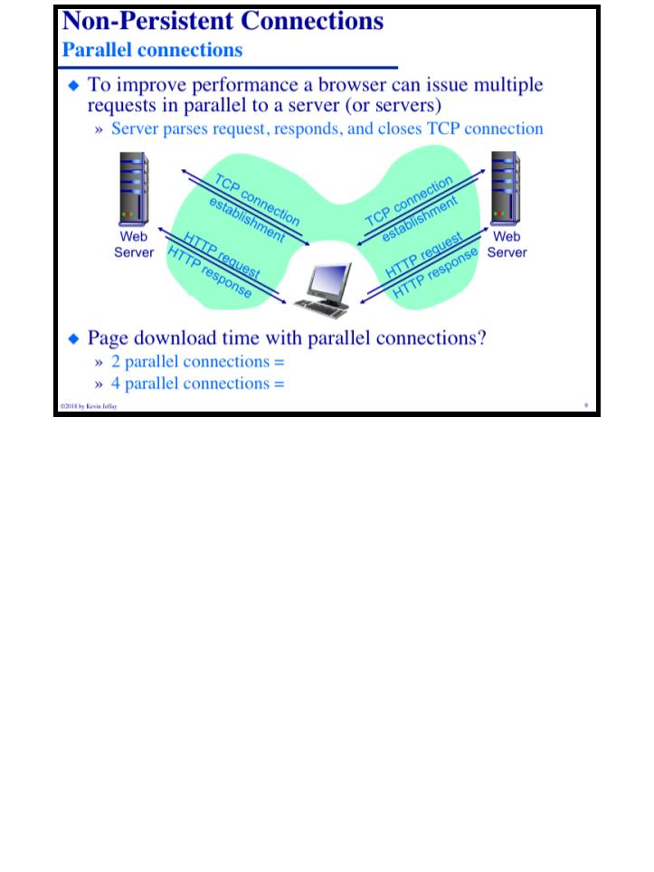
COMP 431
Lecture 5, HTTP Persistence & Caching
September 10, 2018
COMP 431
© 2018 by Kevin Jeffay
Lecture 5, HTTP Persistence & Caching
September 10, 2018
© 2018 by Kevin Jeffay
Page 7
Page 9

Slide 5
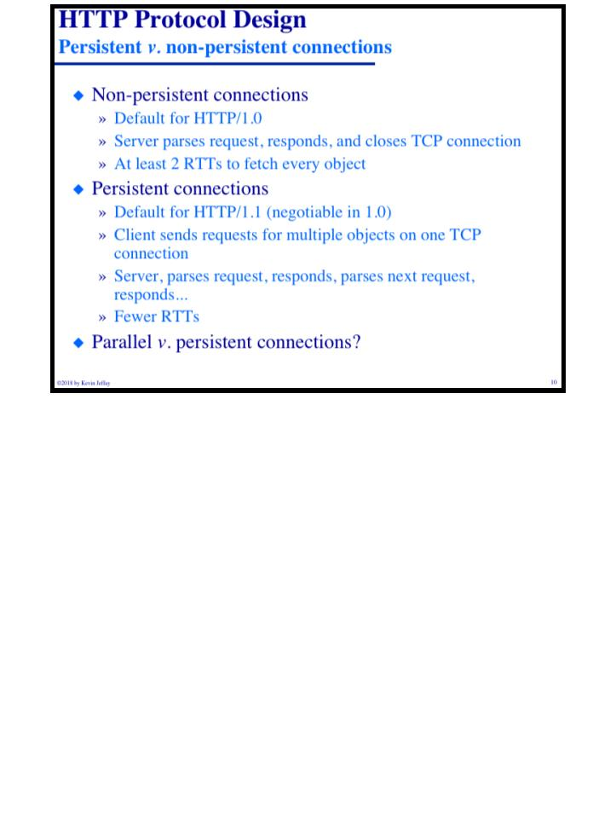
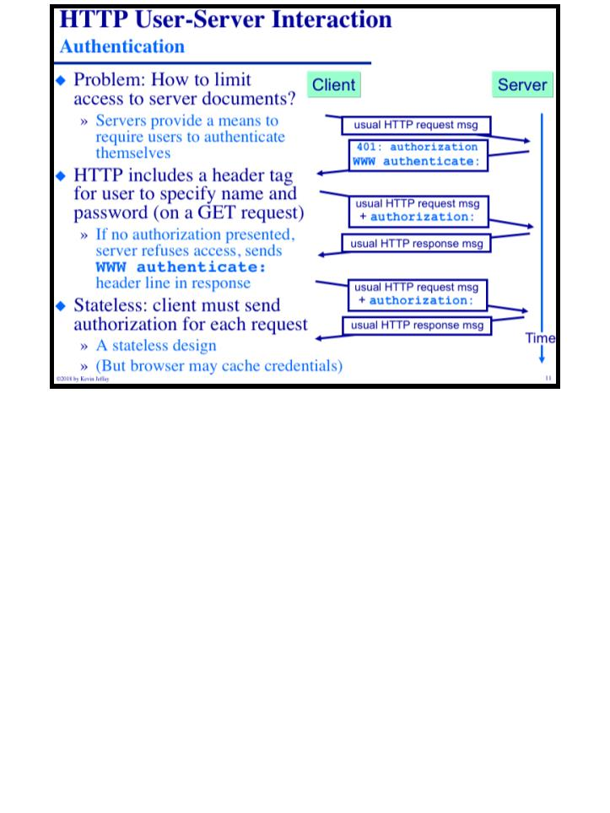
COMP 431
Lecture 5, HTTP Persistence & Caching
September 10, 2018
COMP 431
© 2018 by Kevin Jeffay
Lecture 5, HTTP Persistence & Caching
September 10, 2018
© 2018 by Kevin Jeffay
Page 10
Page 11

Slide 6
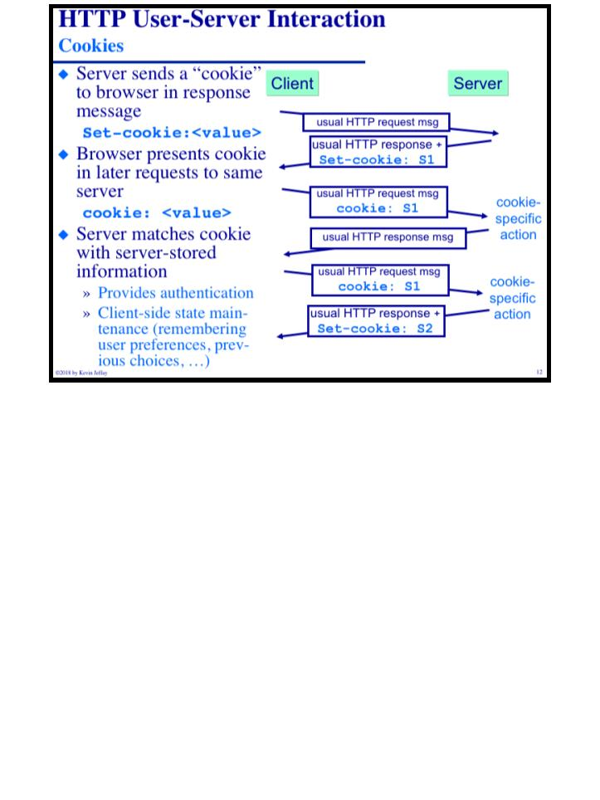
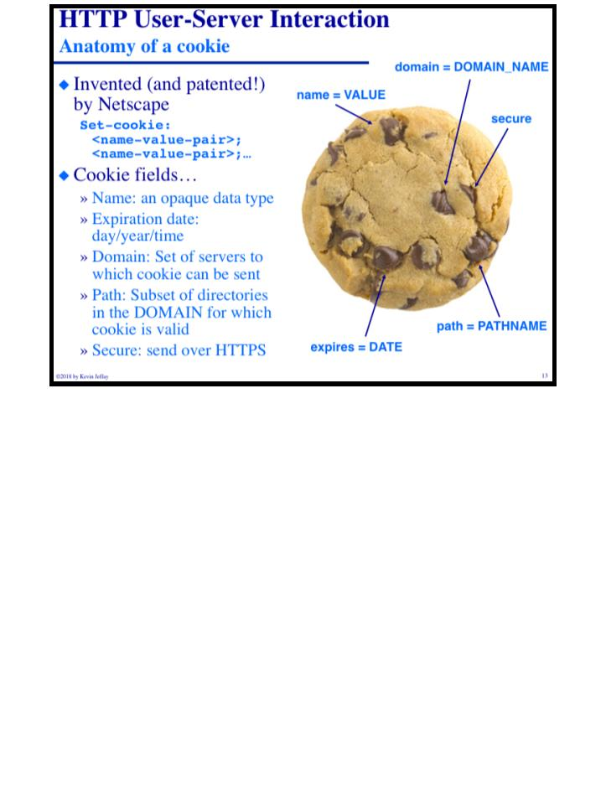
COMP 431
Lecture 5, HTTP Persistence & Caching
September 10, 2018
COMP 431
© 2018 by Kevin Jeffay
Lecture 5, HTTP Persistence & Caching
September 10, 2018
© 2018 by Kevin Jeffay
Page 12
Page 13

Slide 7
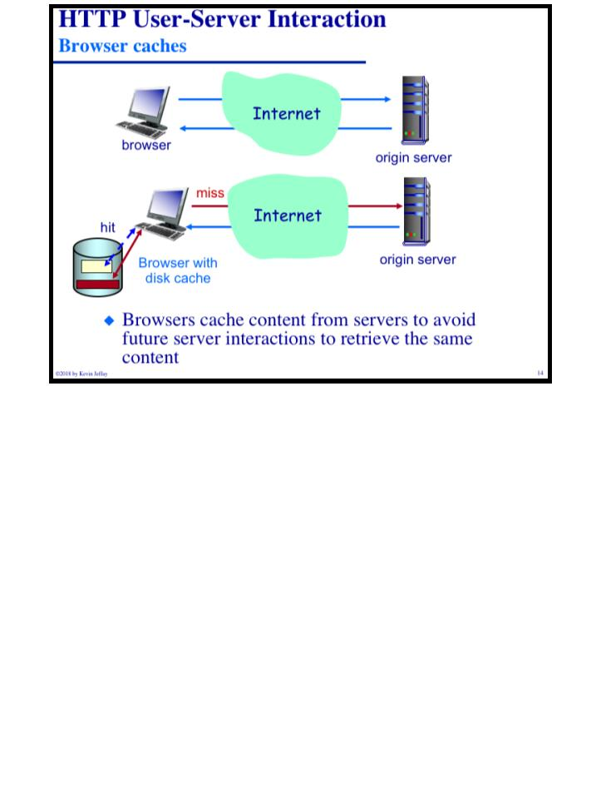
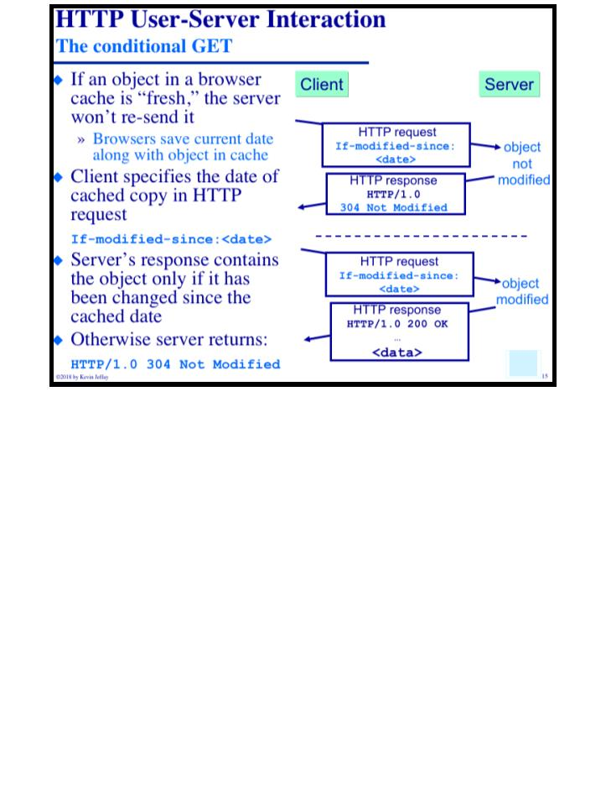
COMP 431
Lecture 5, HTTP Persistence & Caching
September 10, 2018
COMP 431
© 2018 by Kevin Jeffay
Lecture 5, HTTP Persistence & Caching
September 10, 2018
© 2018 by Kevin Jeffay
Page 14
Page 15

Slide 8
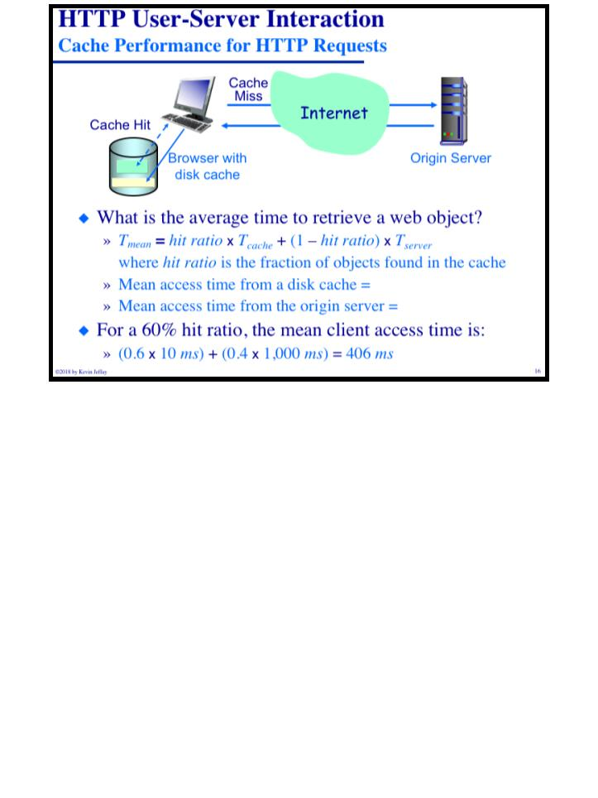
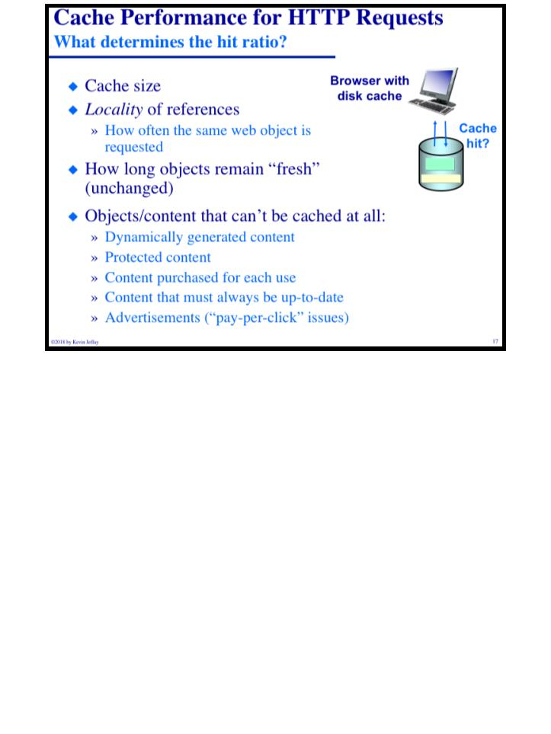
COMP 431
Lecture 5, HTTP Persistence & Caching
September 10, 2018
COMP 431
© 2018 by Kevin Jeffay
Lecture 5, HTTP Persistence & Caching
September 10, 2018
© 2018 by Kevin Jeffay
Page 16
Page 17
Notes:
Mean access tmime from disk cache is 10-20 ms
Origin server is like a second, but it all depends on propogation delay and that stuff

Slide 9
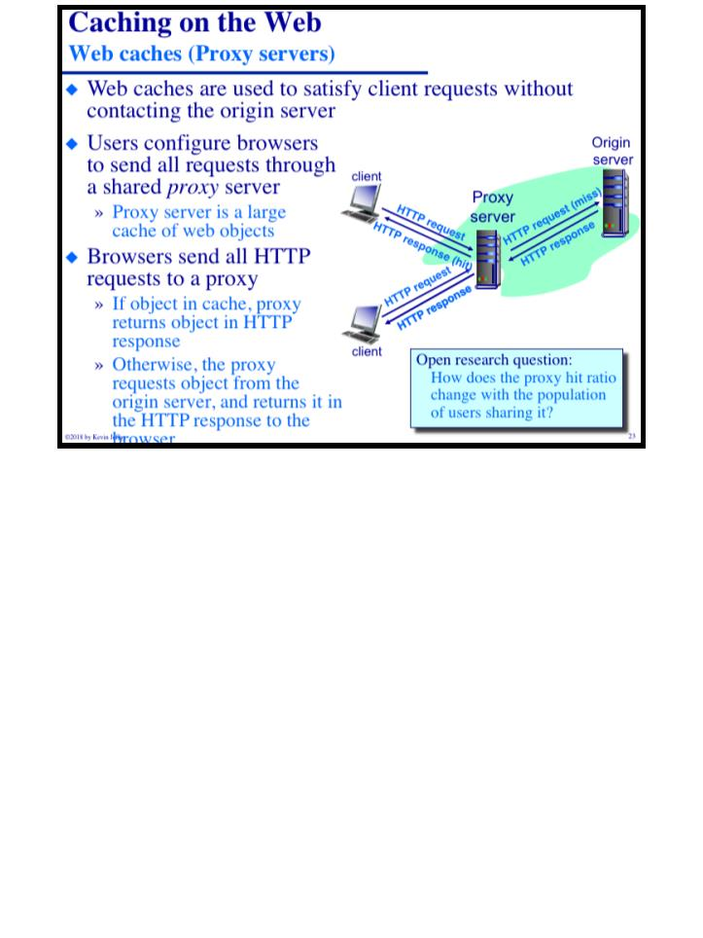
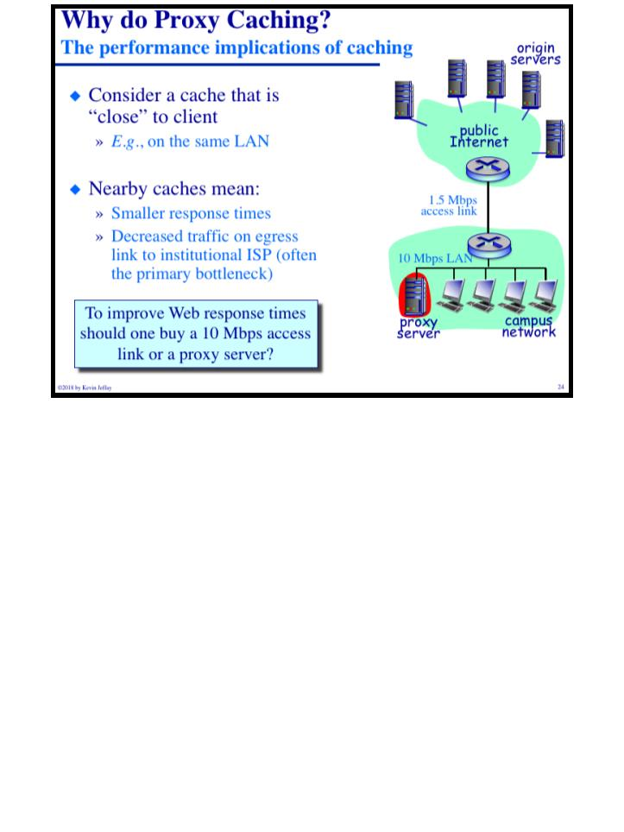
COMP 431
Lecture 5, HTTP Persistence & Caching
September 10, 2018
COMP 431
© 2018 by Kevin Jeffay
Lecture 5, HTTP Persistence & Caching
September 10, 2018
© 2018 by Kevin Jeffay
Page 23
Page 24

Slide 10
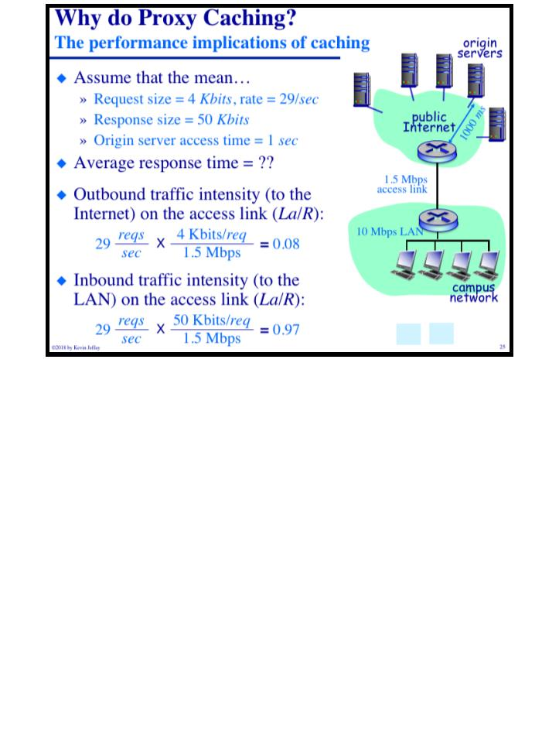
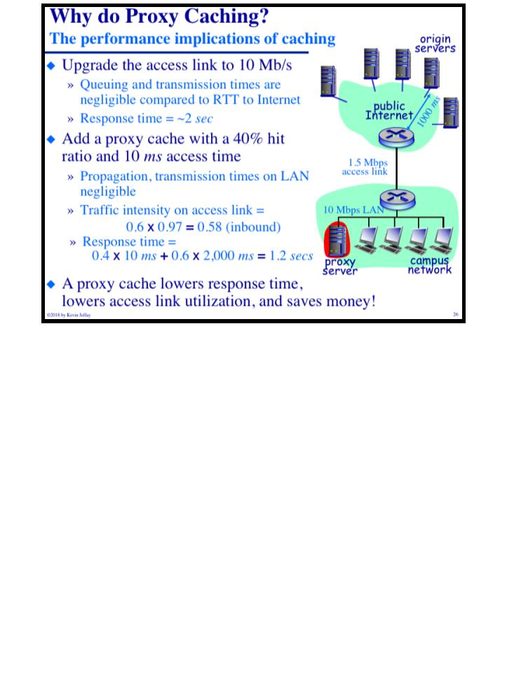
COMP 431
Lecture 5, HTTP Persistence & Caching
September 10, 2018
COMP 431
© 2018 by Kevin Jeffay
Lecture 5, HTTP Persistence & Caching
September 10, 2018
© 2018 by Kevin Jeffay
Page 25
Page 26
Notes:
.08 is

Slide 11
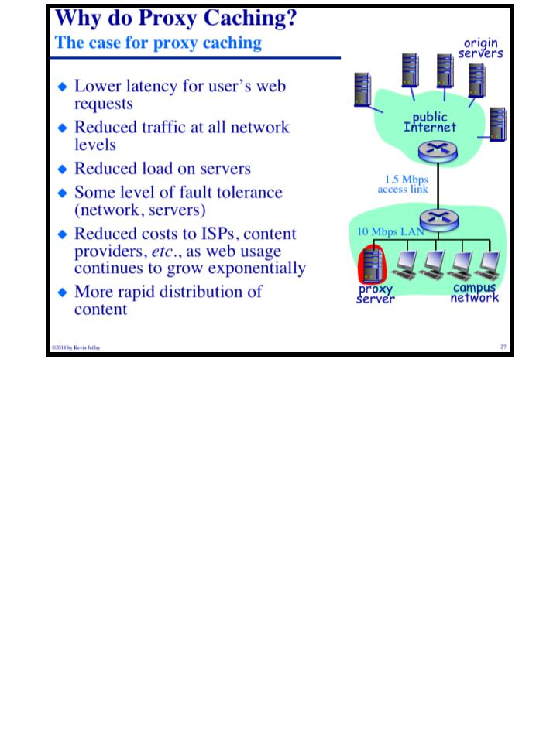
COMP 431
Lecture 5, HTTP Persistence & Caching
September 10, 2018
© 2018 by Kevin Jeffay
Page 27

